Slide 1
PROJECT
NETFLIX
SUBMITTED BY: LALIT -IDD 17
SHYAM-BTECH 85

Slide 2
MAIN FEATURES:
(~)A responsive signup and login page,which can only let you pass if all the information has been correct and also tells you what are you doing wrong while logging in .
(~)A user can create multiple profile whether it’s an adult or your child, the website has filter options so that your the mature audience can watch what it wants and the kids could watch which is not inappropriate for them.
(~)Many different movie to watch
(~)Play movie

Slide 3
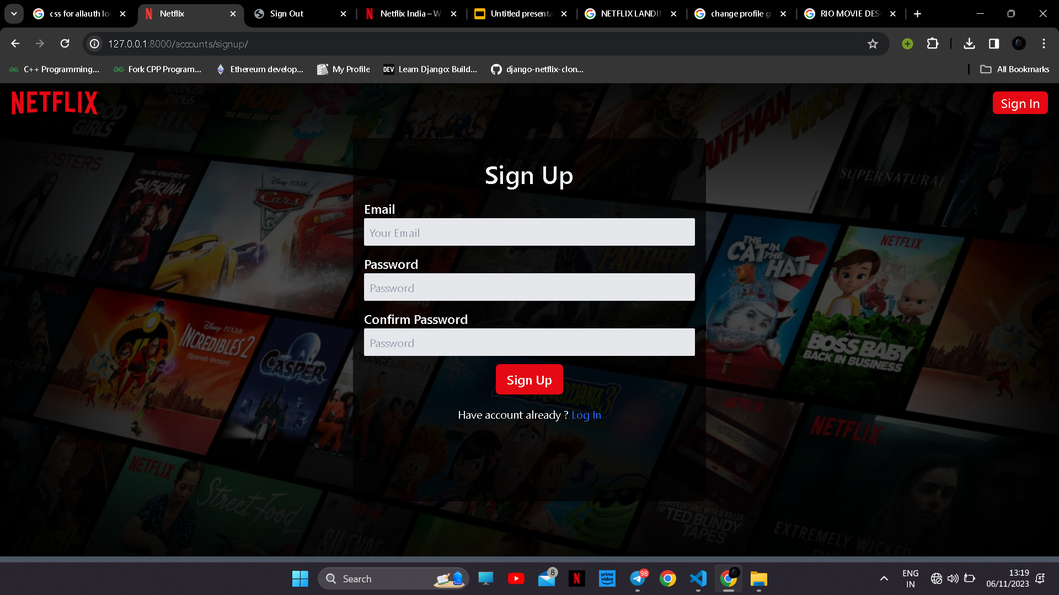
LOGIN AND SIGN UP PAGE

Slide 4
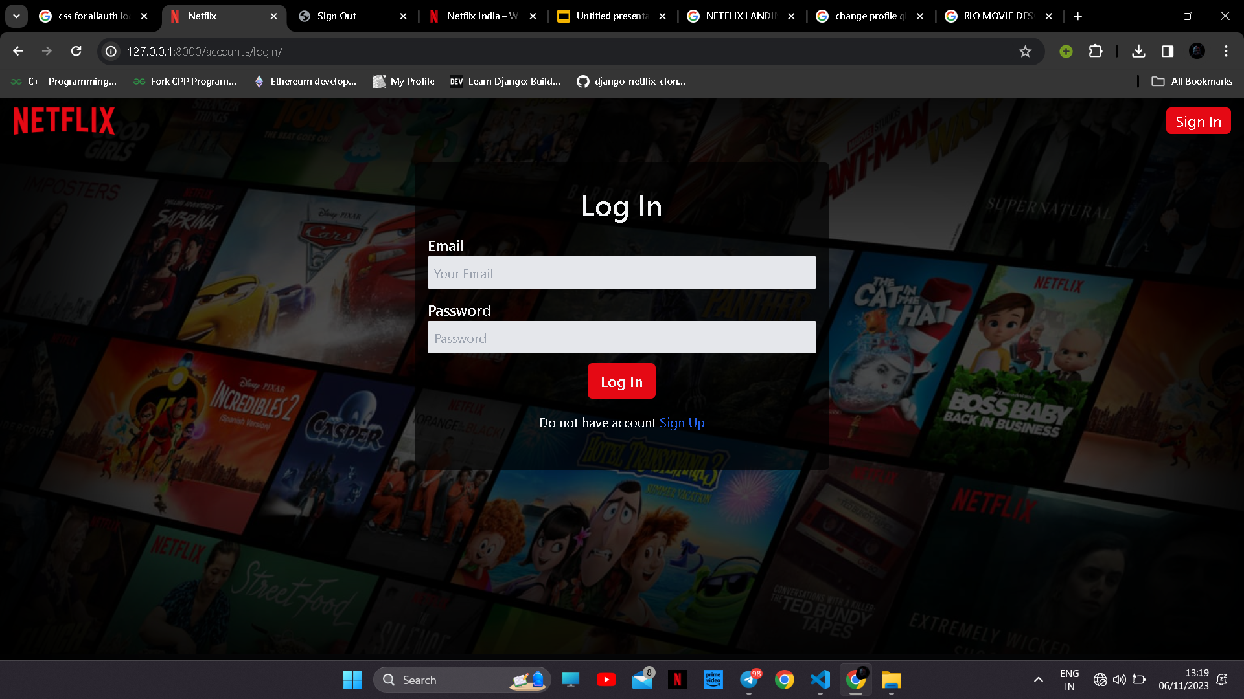

Slide 5
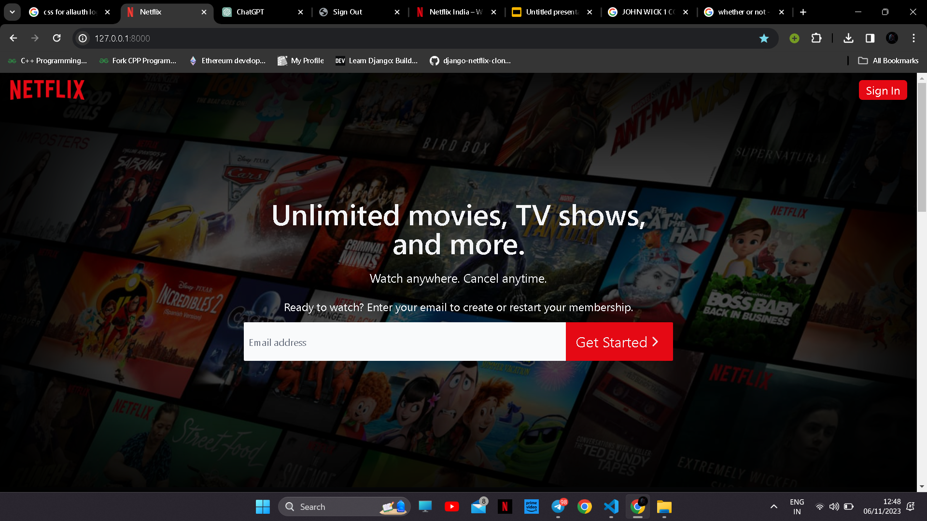
Homepage

Slide 6
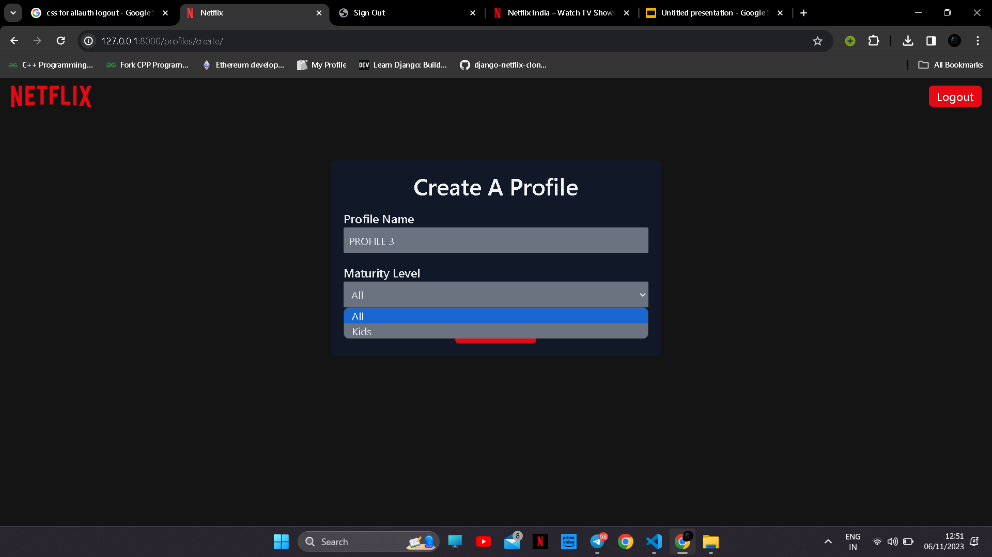
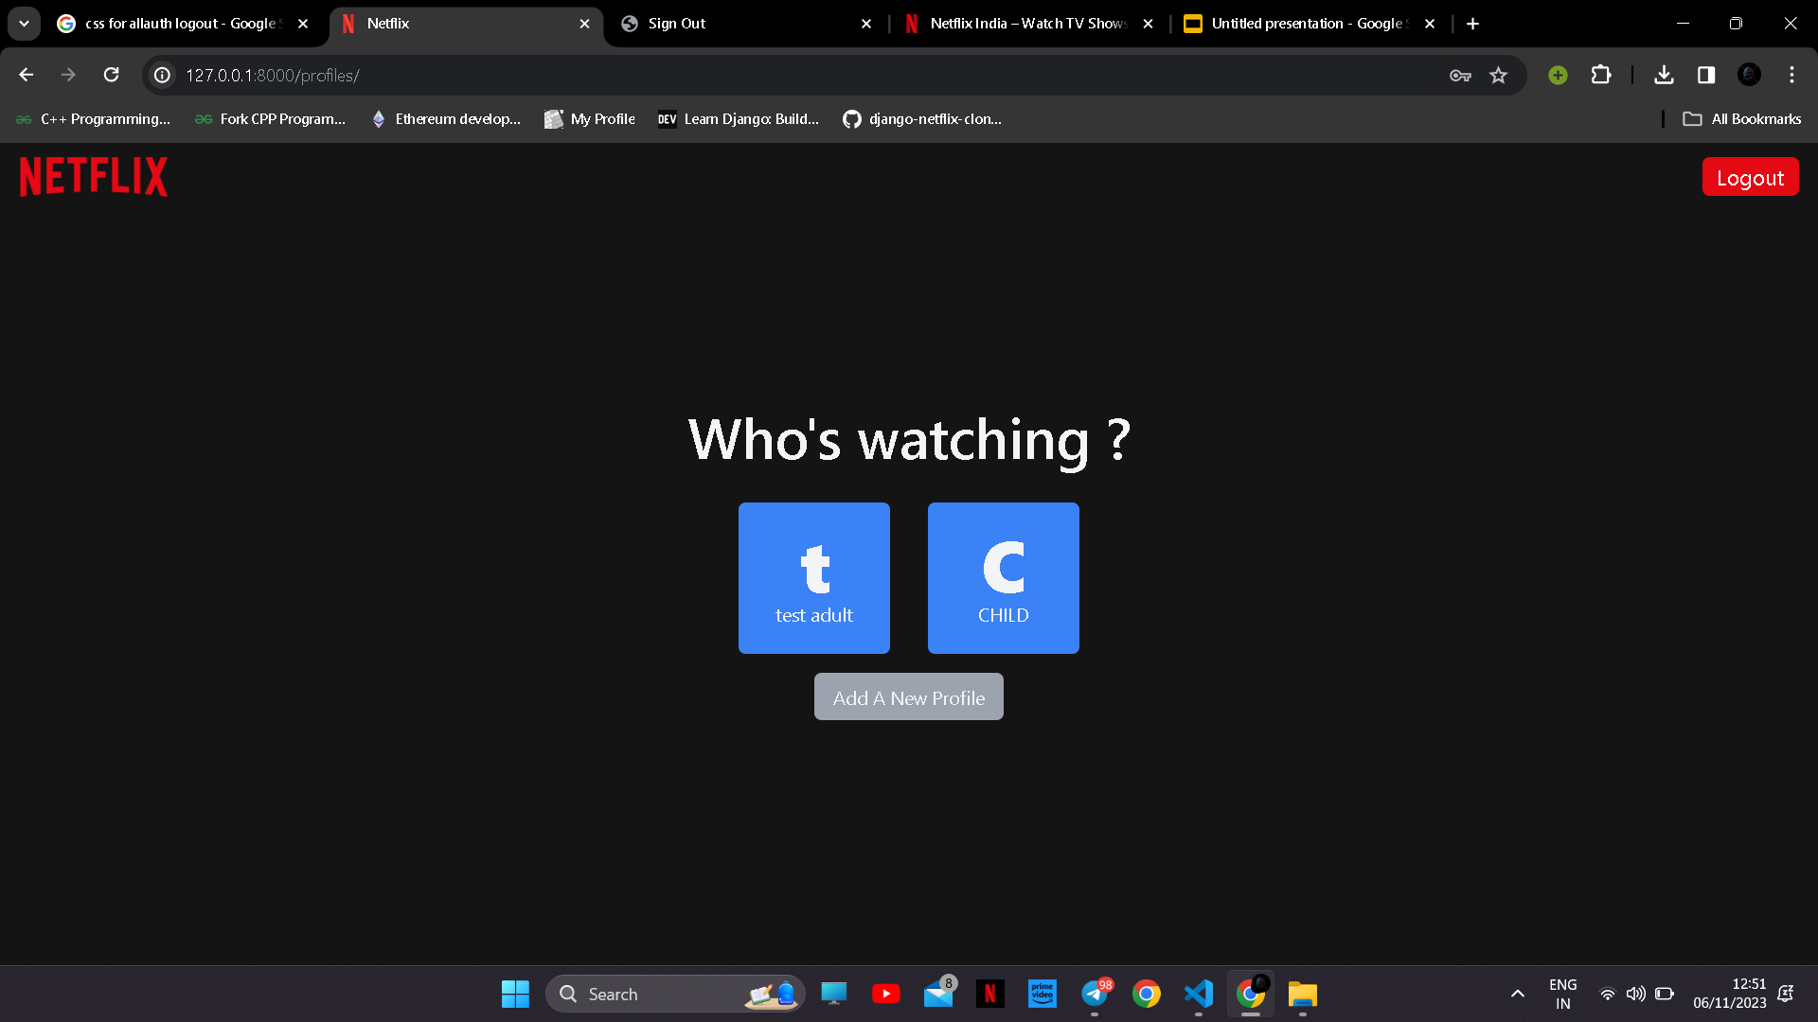
ADD TWO OR MORE PROFILE

Slide 7
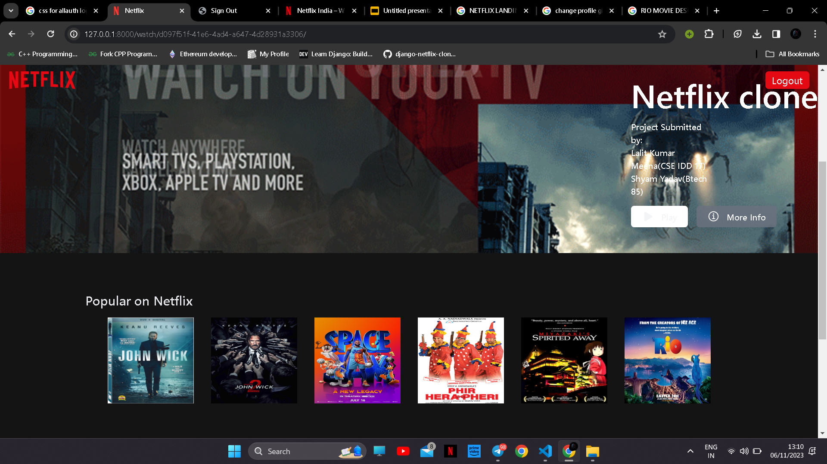
NETFLIX
LANDING PAGE
WATCH ANYTHING!!!

Slide 8
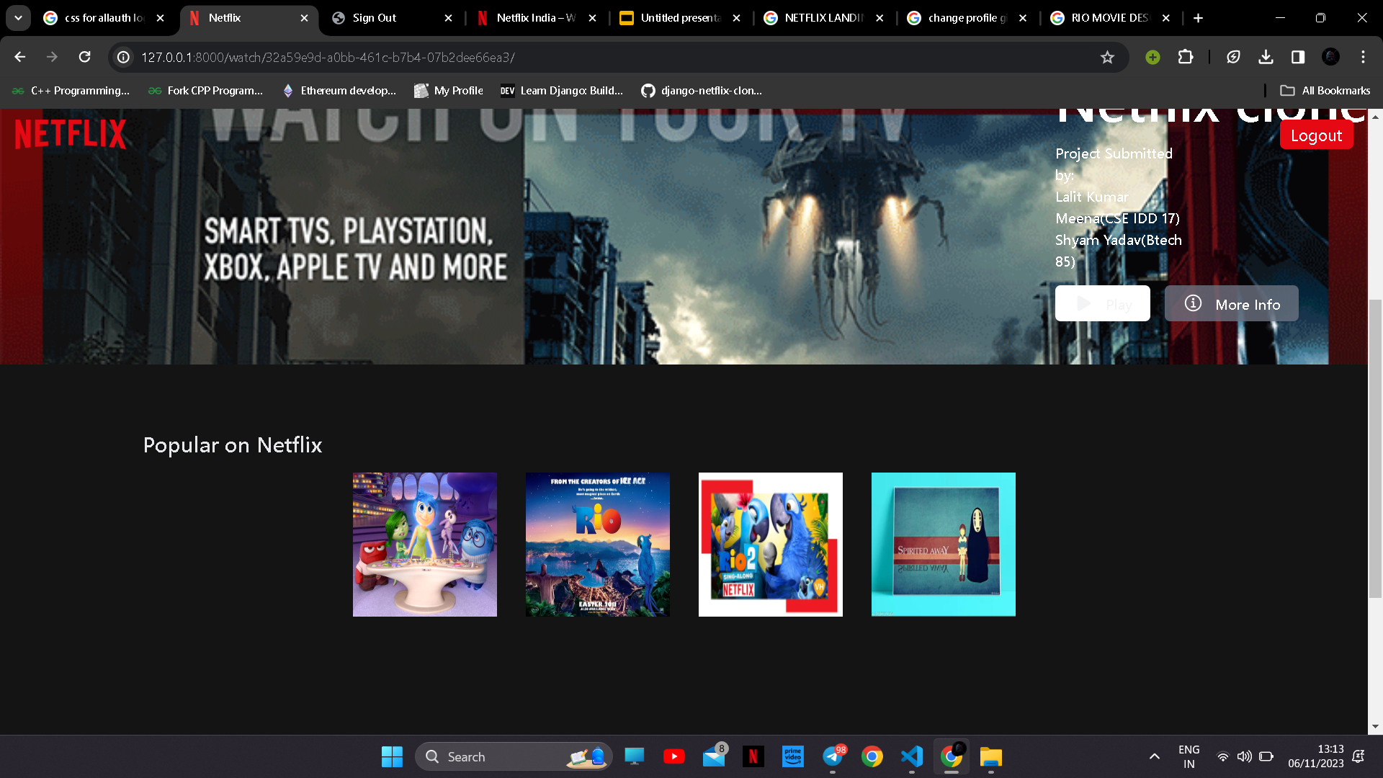
KIDS SECTION AND ADULT SECTION

Slide 9
THANKSSSSS

